Slide 1
3-D Mapping With an RGB-D Camera
Felix Endres, Jurgen Hess, Jurgen Sturm, Daniel Cremers, Wolfram Burgard
Department of Computer Science, University of Freiburg
Department of Computer Science, Technische Universität Münichen
IEEE TRANSACTIONS ON ROBOTICS, VOL. 30, NO. 1, FEBRUARY 2014

Slide 2
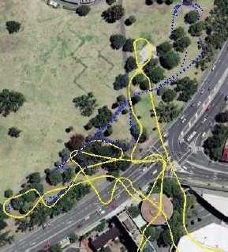
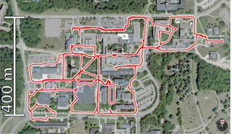
Simultaneous Localization and Mapping
Essential task for the autonomy of a robot
Three main areas: localization, mapping and path planning
Building a global map of the visited environment and, at the same time, utilizing this map to deduce its own location at any moment.

Slide 3

Sensors
Exteroceptive sensors:
Sonar
Range lasers
Cameras
GPS
Proprioceptive sensors:
Encoders
Accelerometers
gyroscopes
Visual SLAM refers to the problem of using images, as the only source of external information.

Slide 4
Pipeline of Visual SLAM
Detection and Recognition
Measure
Visual Sensor
Feature Extraction
Feature Matching
Visual Odometry
Localization
Map Representation
Graph Optimization
Create Map
Feature matching accuracy
Robust and fast visual odometry
Globally consistent trajectory
Efficient 3-D Mapping

Slide 5
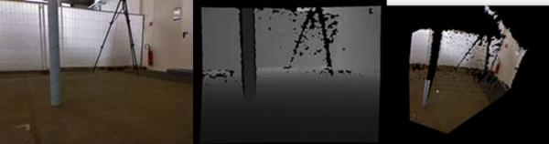
RGB-D
RGB Image
Depth Image
Point Cloud Image

Slide 6
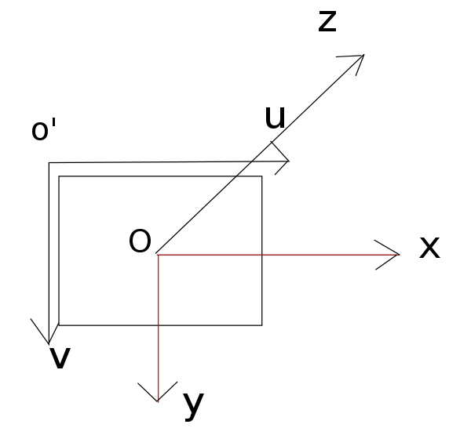
RGB-D coordinate system

Slide 7
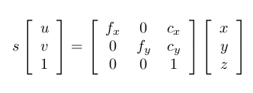
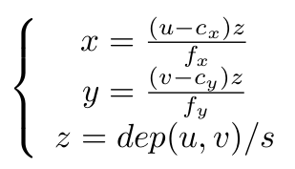
RGB-D Coordinate Transformation
dep(u,v): depth data s: zoom factor f: focal distance c: center
(u,v): point in rgb image (x,y,z): position in 3D

Slide 8
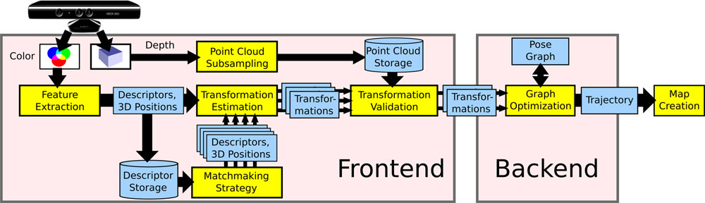
System Architecture Overview
Create a 3-D probabilistic occupancy map
Process the sensor data to extract geometric relationships
Construct a graph
that represents the geometric relations and their uncertainties

Slide 9
Egomotion Estimation
Processes the sensor data to extract geometric relationships between the robot and landmarks at different points in time.
In the case of an RGB-D camera, the input is an RGB image I_{RGB} and a depth image I_{D} .
Determine landmarks by extracting a high-dimensional descriptor vector d from I_{RGB} and storing them together with y , their location relative to the observation pose x .

Slide 10
Egomotion Estimation
Landmark positions
Geometric relations
Robot state
Keypoint descriptors

Slide 11


Features and Distance
SIFT
Euclidean distance
Hellinger Distance
SURF
ORB
Hamming Distance

Slide 12
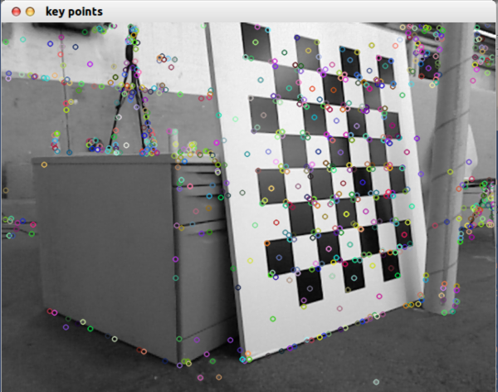
Keypoints With SIFT

Slide 13
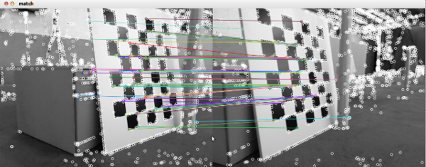
Match
There are mismatches.

Slide 14
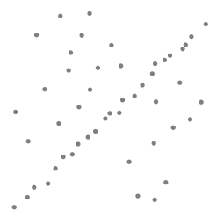
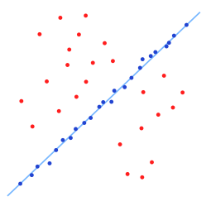
RANSAC（RANdom SAmple Consensus随机抽样一致）
A data set with many outliers for which a line has to be fitted.
Fitted line with RANSAC; outliers have no influence on the result

Slide 15
RANSAC Steps
Select a random subset of the original data. Call this subset the hypothetical inliers.
A model is fitted to the set of hypothetical inliers.
All other data are then tested against the fitted model. Those points that fit the estimated model well, according to some model-specific loss function, are considered as part of the consensus set.
The estimated model is reasonably good if sufficiently many points have been classified as part of the consensus set.
Afterwards, the model may be improved by reestimating it using all members of the consensus set.

Slide 16
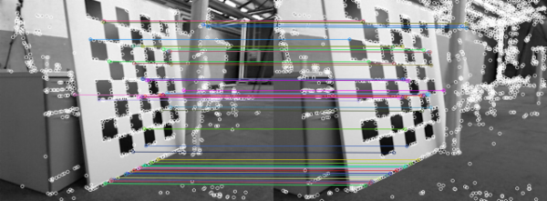
Match After RANSAC
Reduce the mismatches.

Slide 17
EMM(Environment Measurement Model )
Low percentage of inliers does not necessarily indicates an unsuccessful transformation estimate and could be a consequence of low overlap between the frames or few visual features, e.g., due to motion blur, occlusions, or lack of texture.
RANSAC using feature correspondences lack a reliable failure detection.
Developed a method to verify a transformation estimate, independent of the estimation method used.
EMM can be used to penalize pose estimates

Slide 18
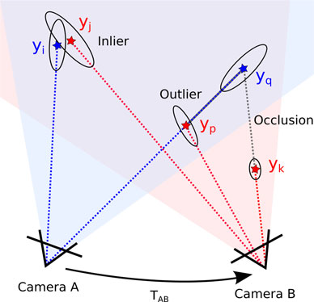
Different Cases of Associated Observations

Slide 19

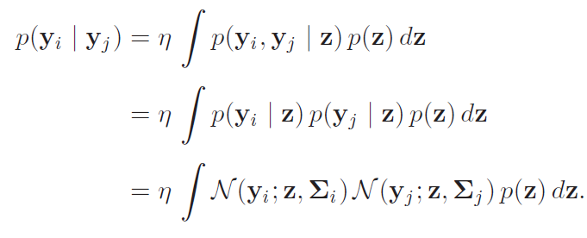
Environment Measurement Model
The probability for the observation y_{i} given an observation y_{j} from a second frame can be computed as
(1)
Since the observations are independent given the true obstacle location z, we can rewrite the right-hand side to
(2)
(3)
(4)

Slide 20

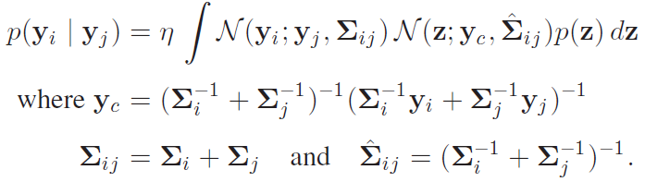
Environment Measurement Model
Exploiting the symmetry of Gaussians, we can write
(5)
The product of the two normal distributions contained in the integral can be rewritten so that we obtain
(6)
(7)
(8)

Slide 21

Environment Measurement Model
The first term in the integral in (6) is constant with respect to z, which allows us to move it out of the integral
(9)
Assume p(z) to be a uniform distribution
(10)

Slide 22
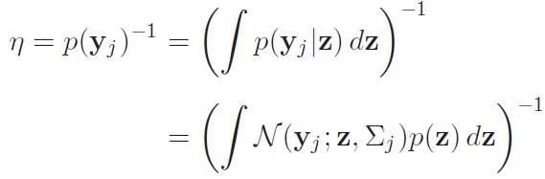
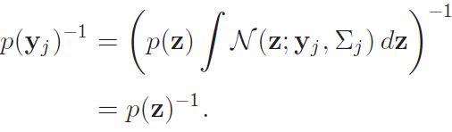
Environment Measurement Model
Expand the normalization factor
(11)
(12)
We obtain
(13)
(14)

Slide 23

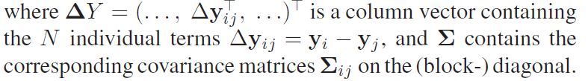
Environment Measurement Model
Combing (10) and (14), we get the final result
(15)
Combine the aforementioned 3-D distributions of all data associations to a 3N-dimensional normal distribution, and assume independent measurements yields
(16)

Slide 24
Different Cases of Associated Observations
We use the hypothesis test on the distribution of the individual observations
and compute the fraction of outliers as a criterion to reject transformation.

Slide 25
Loop Closure Search
Drastically Reduce the accumulating error.
A more efficient strategy to select candidate frames for which to estimate the transformation

Slide 26
The Accumulating Error
v
Landmark
x2
v
Robot
x1
x3
Error
x5
x6
x4
e5
e6
e4
e1
e2
e3
t
The pose estimate is in gross error (as is often the case following a transit around a long loop).

Slide 27
Loop Closure Search
v
Landmark
x2
v
Robot
x1
x3
Error
x5
x6
x4
e4
e6
e1
e2
e3
e5
t
Loop closure is the act of correctly asserting that a vehicle has returned to a previously visited location.
Reduce the gross error.

Slide 28
Combine Several Motion Estimates
v
Landmark
x2
v
Robot
x1
x3
Error
x5
x6
x4
e4
e6
e1
e2
e3
e5
t
Combining several motion estimates, additionally estimating the transformation to frames other than the direct predecessor substantially increases accuracy and reduces the drift .
This increases the computational expense linearly with the number of estimates.

Slide 29
Loop Closure Search
Require a more efficient strategy to select candidate frames for which to estimate the transformation.
Strategy with three different types of candidates:
Apply the egomotion estimation to n immediate predecessors.
Search for loop closures in the geodesic (graph-) neighborhood of the previous frame.
Remove the n immediate predecessors from the node and randomly draw k frames from the tree with a bias toward earlier frames.

Slide 30
Large Loop Closure
To find large loop closures, we randomly sample l frames from a set of designated keyframes.
A frame is added to the set of keyframes, when it cannot be matched to the previous keyframe.
This way, the number of frames for sampling is greatly reduced, while the field of view of the frames in between keyframes always overlaps with at least one keyframe.

Slide 31
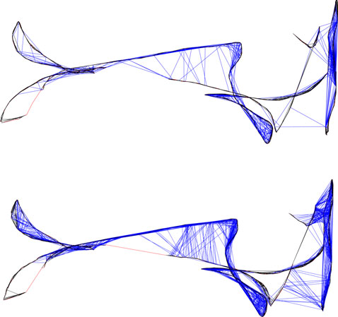
Comparison Between A Pose Graph Constructed Without and With Sampling of The Geodesic Neighborhood
Top:
n = 3 immediate predecessors
k = 6 randomly sampled keyframes
Bottom:
n = 2 immediate predecessors
k = 3 randomly sampled keyframes
l = 2 sampled frames from the
geodesic neighborhood
On the challenging “Robot SLAM” dataset, the average error is reduced by 26 %.

Slide 32
Graph Optimization
Transformation estimates between sensor poses form the edges of a pose graph.
The edges form no globally consistent trajectory.
General graph optimization(g²o) framework.
Errors in motion estimation.
Prune edges.

Slide 33
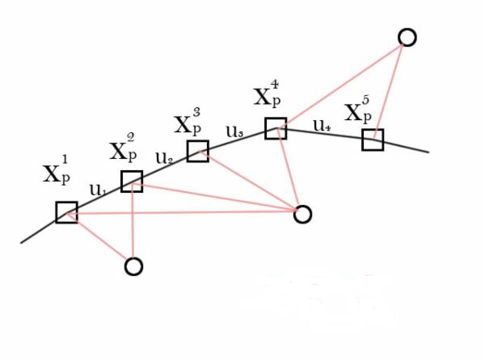
An Example of Graph

Slide 34



Graph Optimization—g²o(general graph optimization)
Use g²o framework, minimize an error function of the form:
To find the optimal trajectory:
Here:
X = is a vector of sensor poses.
z_{ij} and Ω_{ij} represent the mean and the information matrix of a constraint relating the poses x_{i} and x_{j .}
e(x_{i}, x_{j}, z_{ij}) is a vector error function that measures how well the poses x_{i} and x_{j} satisfy the constraint z_{ij}.

Slide 35
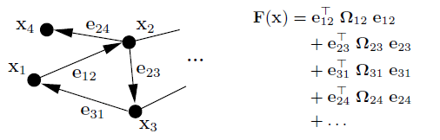
Objective Function by A Graph

Slide 36



Rewrite F(x)
We obtain:
Update step:
Apply nonlinear operator:

Slide 37
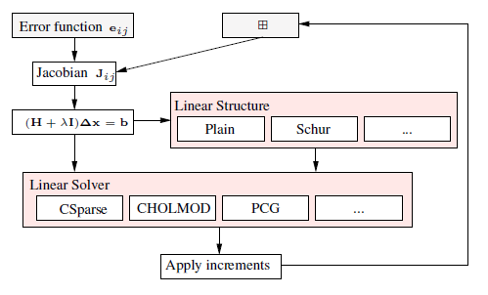
g²o (general graph optimization) Framework

Slide 38

Edge Pruning
In some cases, graph optimization may also distort the trajectory.
Increased robustness can be achieved by detecting transformations that are inconsistent to other estimates.
Do this by pruning edges after optimization based on the Mahalanobis distance obtained from g²o.

Slide 39
Map Representation
Project the original point measurements into a common coordinate frame.

Slide 40
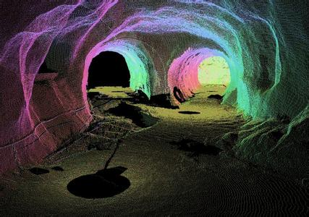
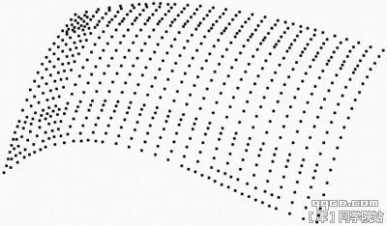
Map Representation
Point cloud
Drawback: Highly redundant and require vast computational and memory resources

Slide 41
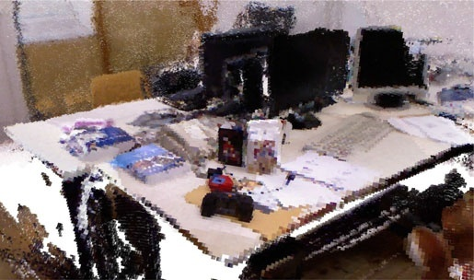
Map Representation
OctoMap: octree-based mapping framework
Explicit representation of free space and unmapped areas, which is essential for collision avoidance and exploration tasks

Slide 42
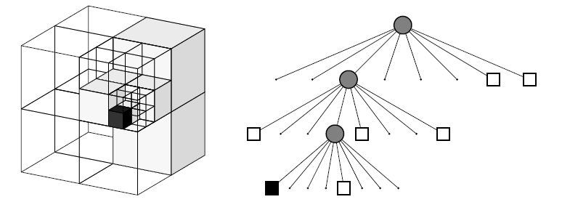
Octree
Octree: a hierarchical data structure for spatial subdivision in 3D
Using Boolean occupancy states or discrete labels allows for compact representations of the octree: If all children of a node have the same state (occupied or free) they can be pruned.

Slide 43
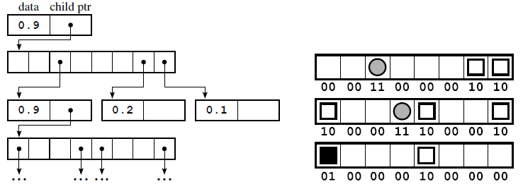
Memory-Efficient Node Implementation
Left: The first nodes of the octree example in memory connected by pointers. Data is stored as one float denoting occupancy.
Right: The complete tree as compact serialized bitstream.

Slide 44
Experiments
RGB-D benchmark
Several sequences captured with two Microsoft Kinect and one Asus Xtion Pro Live sensor
Synchronized ground truth data for the sensor trajectory
Hardware:
An Intel Core i7 CPU with 3.40GHZ
An nVidia GeForce GTX 570 graphics card

Slide 45
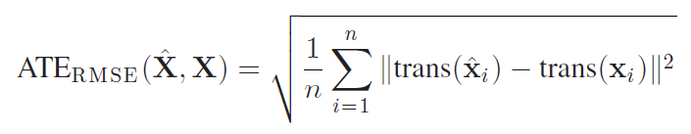

Trajectory Error Metric
The root-mean-square of the absolute trajectory error
: trajectory estimate
: ground truth

Slide 46
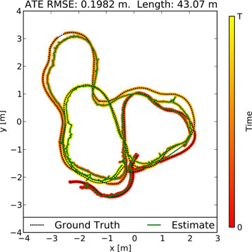
Trajectory Estimate
A 2-D projection of the ground truth trajectory for the “fr2/pioneer_slam” sequence and a corresponding estimate of our approach

Slide 47
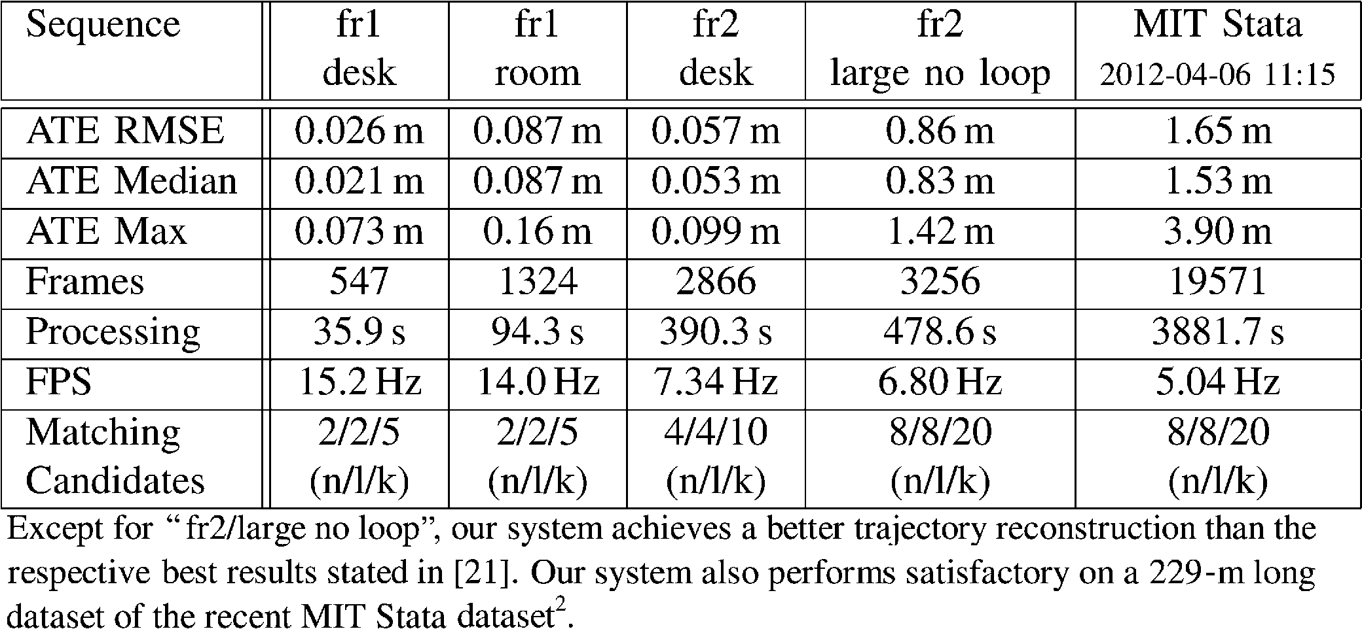
Detailed Results Obtained With the Presented System

Slide 48
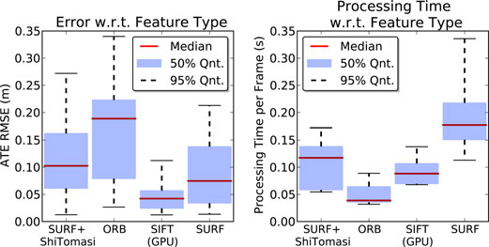
Visual Features Comparison
The keypoint detectors and descriptors offer different tradeoffs between accuracy and processing times.

Slide 49
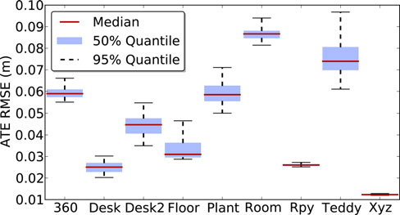
Detailed Results Per Sequence of the “fr1” dataset Using SIFT Features

Slide 50
The Number of Features Extracted Per Frame
SIFT
Increasing the number of features until About 600 to 700 improves the accuracy.
No noticeable impact on accuracy was obtained when using more features.

Slide 51
With Hellinger Distance Instead of Euclidean Distance
SIFT and SURF
Improvement of up to 25.8% for some datasets
However, for most sequence in the used dataset, improvement was not significant
Neither increases the runtime nor the memory requirements noticeably
Suggest the adoption of the Hellinger distance
.

Slide 52
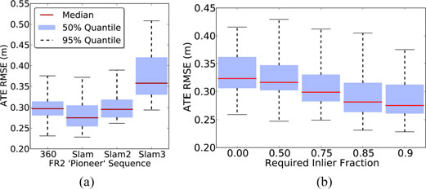
Evaluation of Proposed EMM
q = I / (I + O)
The use of the EMM decreases the average error for thresholds on the quality measure from 0.25 to 0.9

Slide 53
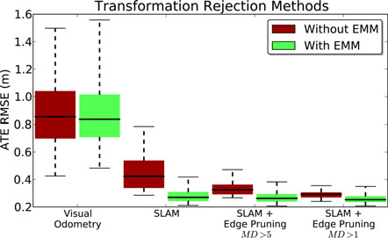
Evaluation of Graph Optimization

Slide 54
Summary
3-D SLAM system for RGB-D sensors
Visual keypoint
Extract visual keypoint : from the color images
Localize visual keypoint: from the depth images
Estimate transformation: RANSAC
Optimize pose graph: nonlinear optimization
Create map: OctoMap
EEM: improve the reliability of the transformation estimates

Slide 55
Thank You Q&A

